Slide 1
Variable Geometries in Turbojet engines
By:
Keegan Jordan
Vishal Patel
Max Starnes

Slide 2
What is Variable Geometry?
var·i·a·ble: able to be changed or adapted.
"the drill has variable speed"
Variable Geometry in a gas turbine engine refers to the dimensions of the engine to be able to “change or adapt” while in flight to increase performance.
Keegan Jordan

Slide 3
Introduction
Variable Geometry
Intake
Bypass Ducts
Compressor
Burner
Nozzle
Turbine
Current Research
Burner Research
Full Scale Engines
Future of VG Engines
Keegan Jordan

Slide 4
Objectives of Research
Where can variable geometry be used within an engine?
How does variable geometry aid gas turbine engine performance?
How does variable geometry aid emissions?
Can these concepts be applied to all sizes of engines effectively?
What does the future of variable geometry gas turbine engines look like in 2024?
Keegan Jordan

Slide 5
Objectives of Research
Where can variable geometry be used within an engine?
How does variable geometry aid gas turbine engine performance?
How does variable geometry aid emissions?
Can these concepts be applied to all sizes of engines effectively?
What does the future of variable geometry gas turbine engines look like in 2024?
Max Starnes

Slide 6
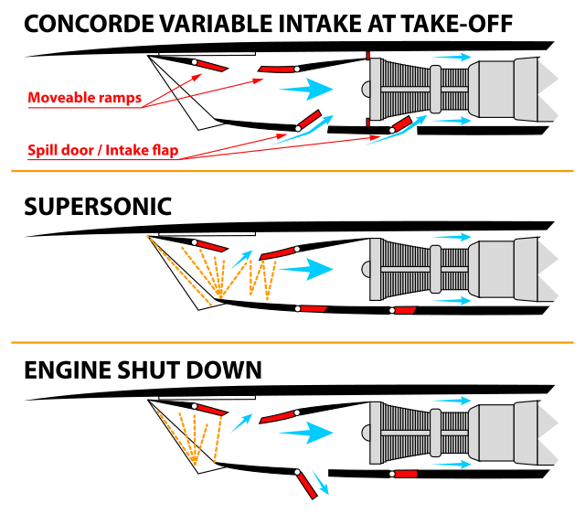
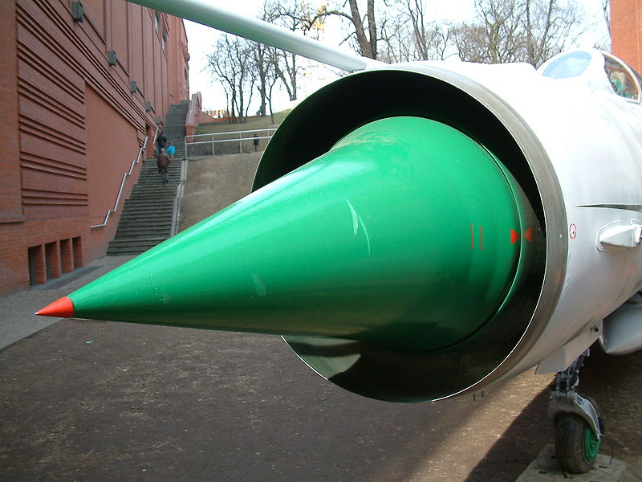
Intake Variable Geometry
Common on first generation Mach One aircraft
Reduces the impact from shockwaves when taking in air below Mach One speed
Slowly transition outed for modern fixed geometry intakes for better performance
Max Starnes

Slide 7
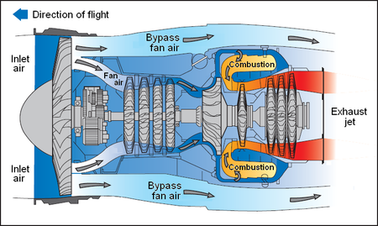
Bypass Duct Variable Geometry (Turbofan)
Used to Control air flow through duct system to control cooling or to adjust flow convergence with turbine exhaust.
Not very common due to increased complexity of design and lack of return.
Max Starnes

Slide 8
Turbine Variable Geometry
Variable pitch of the turbine blades allows for variable compression.
More common in power plant turbines. Due to lower operating temperatures of fluid.

Slide 9
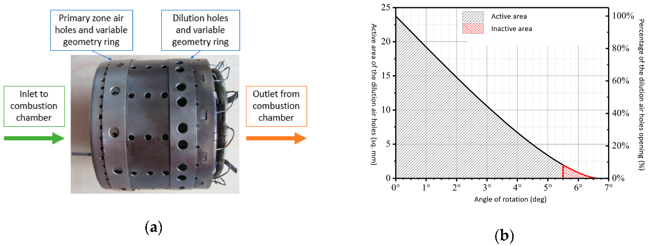
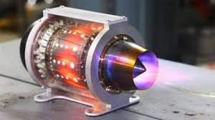
Burner Variable Geometry
Allows for increased efficiency in combustion and performance.
Creates a wider range of operation.
Allows for greater temperature control.
The focus of Variable Geometry in current research.
Max Starnes

Slide 10
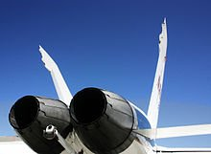
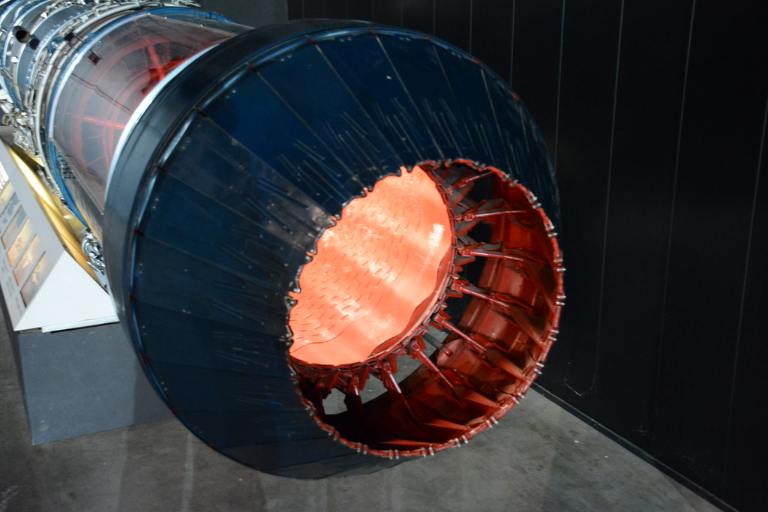
Nozzle Variable Geometry
Most common on military aircrafts for their high speeds and effectiveness on afterburners.
One factor in reducing emissions
Improving thermal efficiency
Max Starnes

Slide 11
Objectives of Research
Where can variable geometry be used within an engine?
How does variable geometry aid gas turbine engine performance?
How does variable geometry aid emissions?
Can these concepts be applied to all sizes of engine effectively?
What does the future of variable geometry gas turbine engines look like in 2024?
Max Starnes

Slide 12
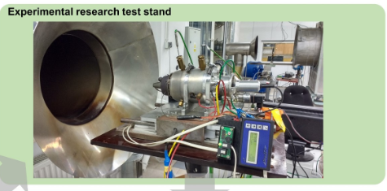
Engine Performance
Studies on mini gas turbines (MGTs) highlight benefits of variable geometry systems for improved thermal performance and significant emissions reduction.
Experimental setups at the Warsaw University of Technology achieved a 47% reduction in fuel consumption and a notable decrease in nitrogen oxides
Max Starnes

Slide 13
Objectives of Research
Where can variable geometry be used within an engine?
How does variable geometry aid gas turbine engine performance?
How does variable geometry aid emissions?
Can these concepts be applied to all sizes of engine effectively?
What does the future of variable geometry gas turbine engines look like in 2024?
Vishal Patel

Slide 14
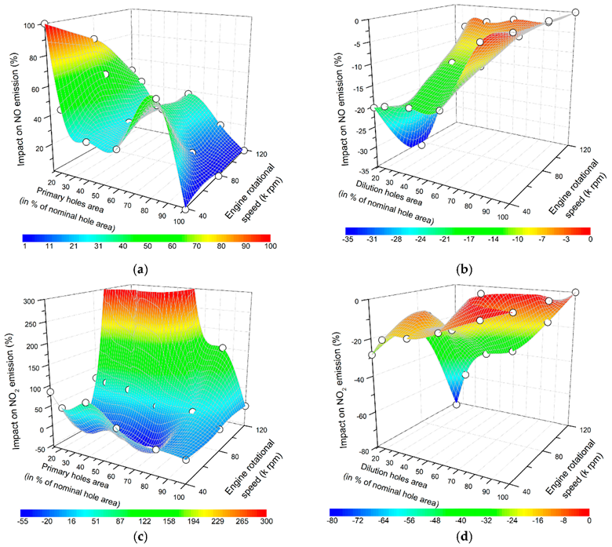
Decreased Emissions
Closing dilution holes of the variable burner meant more air stayed in the primary combustion zone, lowering NO2 emissions by up to 82%.
Adjusting the turbine nozzle also helped reduce emissions by controlling how air and fuel mixed and burned.
Vishal Patel

Slide 15
Objectives of Research
Where can variable geometry be used within an engine?
How does variable geometry aid gas turbine engine performance?
How does variable geometry aid emissions?
Can these concepts be applied to all sizes of engine effectively?
What does the future of variable geometry gas turbine engines look like?
Vishal Patel

Slide 16
Applying Research to Full Scale Engines
Translation from small to large scale will be simple in theory.
Small conceptual engines will continue to be the most effective way to test many of the variables inherent to burner efficiency.
Vishal Patel

Slide 17
Objectives of Research
Where can variable geometry be used within an engine?
How does variable geometry aid gas turbine engine performance?
How does variable geometry aid emissions?
Can these concepts be applied to all sizes of engine effectively?
What does the future of variable geometry gas turbine engines look like?
Keegan Jordan

Slide 18
Current Research/Patents
Today, most research into variable geometry is focused on the burner.
Testing is being done with mini turbojet engines (MGT). The only large-scale testing is used in variable nozzles.
Multiple patents are held by major engine manufactures and their subsidiaries for different variable burner designs.
Keegan Jordan

Slide 19
The Future of Variable Geometry in flight
This technology has the capability to allow for faster, more capable, and more efficient aircraft.
Artificial intelligence will be able to optimize the engine performance of aircraft based on altitude, fuel consumption, temperature, flight duration and target speed of the flight, among other things.
Smaller engines and less fuel consumption will mean more economic flights, leading to less expense for consumers.
Keegan Jordan

Slide 20
Conclusion
Benefits of VG overall.
Possible issues with VG engines as opposed to current designs.
Final thoughts.
Questions?
Max Starnes

